Slide 1
Design Patterns

Slide 2
Why Design Patterns?
Design patterns are advanced object-oriented solutions to commonly occurring software problems.
They provide you with a way to solve issues related to software development using a proven solution.
It makes communication between designers more efficient.
Software professionals can immediately picture the high-level design in their heads when they refer the name of the pattern used to solve a particular issue when discussing system design.
Ex: "I used a factory to create that object" everyone will understand that you are talking about factory method design pattern.
It saves your time. You don't need to use your brain to re-create a possible solution from nowhere and lose lots of time
The 23 Gang of Four (GoF) patterns are generally considered the foundation for all other patterns.

Slide 3
Categorization of design patterns
Creational Design Pattern
Structural Design Pattern
Behavioral Design Pattern

Slide 4
Creational Design Pattern
Creational patterns are associated with control mechanisms of creating objects.
The basic mode of forming an object may be problematic in some projects and may lead to unnecessary complexity in some areas.
Sometimes, the nature of the object must be changed according to the nature of the program. In such cases, we must get the help of creational design patterns to provide more general and flexible approach.

Slide 5
Types of creational design patterns
Factory Method Pattern
Abstract Factory Pattern
Singleton Pattern
Prototype Pattern
Builder Pattern

Slide 6
Singleton Pattern
This is the most used pattern.
A lot of framework already implement this pattern, such as Spring, CDI.
The singleton pattern is used to limit creation of a class to only one object.
This is beneficial when one (and only one) object is needed to coordinate actions across the system.
In Java, the new keyword creates an instance of a class whenever required. But there are some cases where developers need to have an isolated instance of a class such as:
A single database connection object
A single shared resource
Therefore, this design pattern ensures that only one instance of a given class is created and a global access to that instance is provided

Slide 7
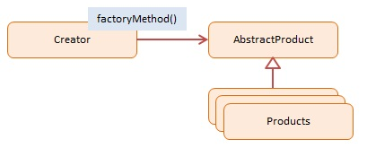
Factory Method Pattern
The Factory Method pattern is one of the best-known design patterns.
A Factory Pattern or Factory Method Pattern says that just define an interface or abstract class for creating an object but let the subclasses decide which class to instantiate.
To accomplish this, objects are created by calling a factory method instead of calling a constructor.
If a product has many classes with a similar base class and you manipulate objects in the interface or abstract class, then Factory Method Patter would definitely be useful.
Usually, object creation in Java takes place like so:
SomeClass someClassObject = new SomeClass();
The problem with the above approach is that the code using the SomeClass’s object, now becomes dependent on the concrete implementation of SomeClass.
It promotes the loose-coupling by eliminating the need to bind application-specific classes into the code. That means the code interacts solely with the resultant interface or abstract class, so that it will work with any classes that implement that interface or that extends that abstract class.

Slide 8
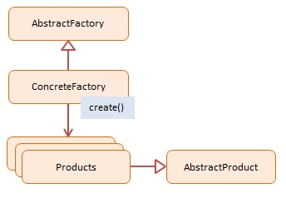
Abstract Factory Pattern
Abstract Factory Pattern says that just define an interface or abstract class for creating families of related (or dependent) objects but without specifying their concrete sub-classes.
An Abstract Factory creates objects that are related by a common theme.
In object-oriented programming a Factory is an object that creates other objects.
An Abstract Factory has abstracted out a theme which is shared by the newly created objects.

Slide 9
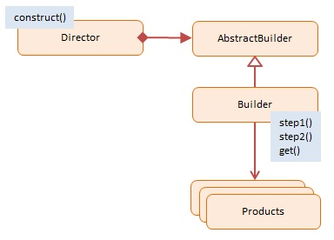
Builder Pattern
Builder Pattern says that "construct a complex object from simple objects using step-by-step approach"
The Builder pattern allows a client to construct a complex object by specifying the type and content only. Construction details are hidden from the client entirely.
The main advantages of Builder Pattern are as follows:
It provides clear separation between the construction and representation of an object.
It provides better control over construction process.
It supports to change the internal representation of objects.

Slide 10
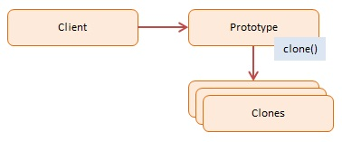
Prototype Pattern
Prototype Pattern says that cloning of an existing object instead of creating new one and can also be customized as per the requirement.
This pattern should be followed, if the cost of creating a new object is expensive and resource intensive.

Slide 11
Structural design patterns
Structural design patterns are concerned with how classes and objects can be composed, to form larger structures.
The most important feature of these patterns is to facilitate the operation and design applications through finding an easy way to realize dependencies between entities i.e., simplifies the structure by identifying the relationships.
Due to this patterns, it is easier to design applications which contain independent class libraries.

Slide 12
Types of structural design patterns
Adapter Pattern
Bridge Pattern
Decorator Pattern
Facade Pattern
Proxy Pattern
Composite Pattern
Flyweight Pattern

Slide 13

Adapter Pattern
An Adapter Pattern says that just "converts the interface of a class into another interface that a client wants".
The Adapter pattern translates one interface to another.
Adapters allows programming components to work together that otherwise wouldn't because of mismatched interfaces.
The Adapter pattern is also referred to as the Wrapper Pattern.

Slide 14
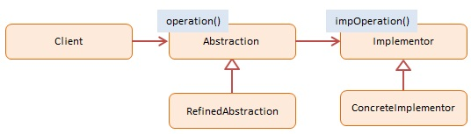
Bridge Pattern
A Bridge Pattern says that just "decouple the functional abstraction from the implementation so that the two can vary independently".
The Bridge pattern allows two components, a client and a service, to work together with each component having its own interface.
Bridge is a high-level architectural pattern, and its main goal is to write better code through two levels of abstraction. It facilitates very loose coupling of objects.
It is sometimes referred to as a double Adapter pattern.

Slide 15
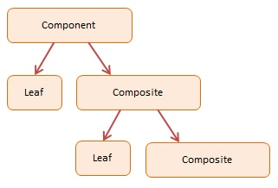
Composite Pattern
A Composite Pattern says that just "allow clients to operate in generic manner on objects that may or may not represent a hierarchy of objects".
The Composite pattern allows the creation of objects with properties that are primitive items or a collection of objects. Each item in the collection can hold other collections themselves, creating deeply nested structures.

Slide 16
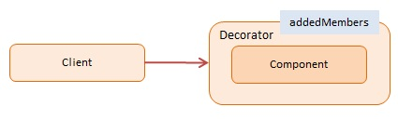
Decorator Pattern
A Decorator Pattern says that just "attach a flexible additional responsibilities to an object dynamically".
The Decorator pattern extends an object’s behavior dynamically.
The ability to add new behavior at runtime is accomplished by a Decorator object which ‘wraps itself’ around the original object.
Multiple decorators can add or override functionality to the original object.

Slide 17
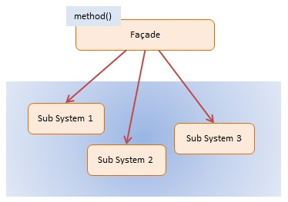
Facade Pattern
A Facade Pattern says that just "just provide a unified and simplified interface to a set of interfaces in a subsystem, therefore it hides the complexities of the subsystem from the client".
The Facade pattern provides an interface which shields clients from complex functionality in one or more subsystems.
It is a simple pattern that may seem trivial, but it is powerful and extremely useful.
It is often present in systems that are built around a multi-layer architecture.
Practically, every Abstract Factory is a type of Facade.

Slide 18
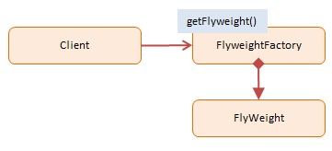
Flyweight Pattern
A Flyweight Pattern says that just "to reuse already existing similar kind of objects by storing them and create new object when no matching object is found".
The Flyweight pattern conserves memory by sharing large numbers of fine-grained objects efficiently.
Shared flyweight objects are immutable, that is, they cannot be changed as they represent the characteristics that are shared with other objects.

Slide 19

Proxy Pattern
The Proxy pattern provides a surrogate or placeholder object for another object and controls access to this other object.
Simply, proxy means an object representing another object.
According to GoF, a Proxy Pattern "provides the control for accessing the original object".
It provides the protection to the original object from the outside world.

Slide 20
Behavioral design patterns
Behavioral design patterns are concerned with the interaction and responsibility of objects.
Behavioral patterns task is to introduce flexibility to solutions connected with inter-objects communication.
In these design patterns, the interaction between the objects should be in such a way that they can easily talk to each other and still should be loosely coupled.

Slide 21
Types of behavioral design patterns
Chain of Responsibility Pattern
Iterator Pattern
Interpreter Pattern
Mediator Pattern
Memento Pattern
Observer Pattern
Command Pattern
Strategy Pattern
State Pattern
Template Pattern
Visitor Pattern

Slide 22

Chain of Responsibility
Chain of Responsibility is a behavioral design pattern that lets you pass requests along a chain of handlers. Upon receiving a request, each handler decides either to process the request or to pass it to the next handler in the chain.
The Chain of Responsibility pattern provides a chain of loosely coupled objects one of which can satisfy a request.

Slide 23
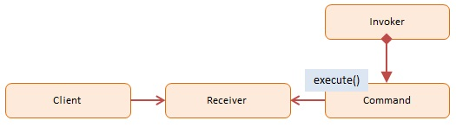
Command
The Command pattern encapsulates actions as objects.
Command objects allow for loosely coupled systems by separating the objects that issue a request from the objects that actually process the request.
These requests are called events and the code that processes the requests are called event handlers.

Slide 24
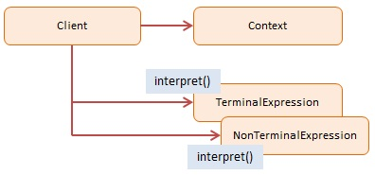
Interpreter
The Interpreter pattern offers a scripting language that allows end-users to customize their solution.
Problems like this, expressed as a grammar, can be implemented using the Interpreter design pattern.

Slide 25
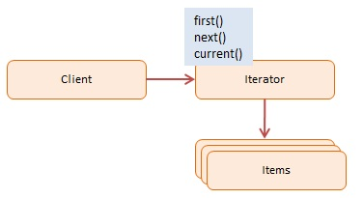
Iterator
The Iterator pattern that lets you traverse elements of a collection without exposing its underlying representation.

Slide 26
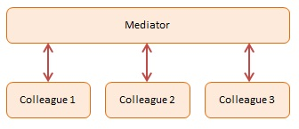
Mediator
The Mediator pattern provides central authority over a group of objects by encapsulating how these objects interact.
This model is useful for scenarios where there is a need to manage complex conditions in which every object is aware of any state change in any other object in the group.

Slide 27
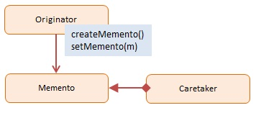
Memento
Memento is a behavioral design pattern that lets you save and restore the previous state of an object without revealing the details of its implementation.

Slide 28
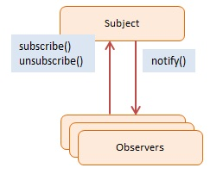
Observer
The Observer pattern offers a subscription model in which objects subscribe to an event and get notified when the event occurs.
This pattern is the cornerstone of event driven programming, including JavaScript.
The Observer pattern facilitates good object-oriented design and promotes loose coupling.

Slide 29
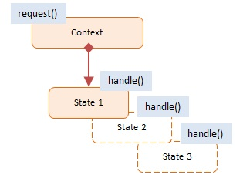
State
State is a behavioral design pattern that lets an object alter its behavior when its internal state changes. It appears as if the object changed its class.

Slide 30
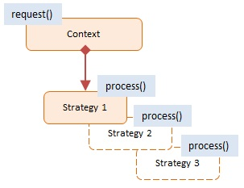
Strategy
Strategy is a behavioral design pattern that lets you define a family of algorithms, put each of them into a separate class, and make their objects interchangeable.

Slide 31
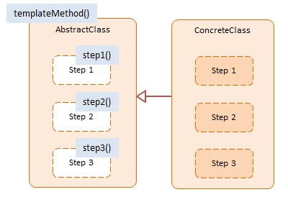
Template Method
Template Method is a behavioral design pattern that defines the skeleton of an algorithm in the superclass but lets subclasses override specific steps of the algorithm without changing its structure.

Slide 32
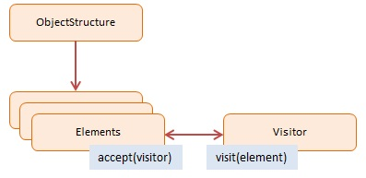
Visitor
The Visitor pattern defines a new operation to a collection of objects without changing the objects themselves.
The new logic resides in a separate object called the Visitor.

